Slide 1
A study on Datasets in Code Auto-completion
Lorenzo Bartolini, Irene Scarpanti, Claudio Soricaro

Slide 2
CodeSearchNet
In this paper, the authors propose one of the biggest available dataset regarding source code.
The corpus contains about 6 million functions
from open-source code spanning six programming languages (Go,
Java, JavaScript, PHP, Python, and Ruby)
It is already divided into train (80%), validation (10%) and test (10%).
https://arxiv.org/pdf/1909.09436

Slide 3
CodeSearchNet
The dataset creation starts from scraping publicly available software on GitHub. The repository without a licence allowing the use of its content are discarded and not considered in this study. Another cleaning procedure done by the authors was to identify and remove duplicate code from the dataset.
It can be divided into two main parts: the part with comments describing the code and the part that contains just the code.
The documentation is truncated so that only the initial and general description of the function is considered in the dataset.

Slide 4
'docstring': 'Extracts video ID from URL.',
'docstring_tokens': ['Extracts', 'video', 'ID', 'from', 'URL', '.'],
'func_name': 'YouTube.get_vid_from_url',
'language': 'python',
'original_string': 'def get_vid_from_url(url):\n'
' """Extracts video ID from URL.\n'
' """\n'
" return match1(url, r'youtu\\.be/([^?/]+)') or \\\n"
" match1(url, r'youtube\\.com/embed/([^/?]+)') or "
'\\\n'
" match1(url, r'youtube\\.com/v/([^/?]+)') or \\\n"
" match1(url, r'youtube\\.com/watch/([^/?]+)') or "
'\\\n'
" parse_query_param(url, 'v') or \\\n"
" parse_query_param(parse_query_param(url, 'u'), "
"'v')",
'partition': 'test',
[...]
}
CodeSearchNet
3
1
{
'code': 'def get_vid_from_url(url):\n'
' """Extracts video ID from URL.\n'
' """\n'
" return match1(url, r'youtu\\.be/([^?/]+)') or \\\n"
" match1(url, r'youtube\\.com/embed/([^/?]+)') or \\\n"
" match1(url, r'youtube\\.com/v/([^/?]+)') or \\\n"
" match1(url, r'youtube\\.com/watch/([^/?]+)') or \\\n"
" parse_query_param(url, 'v') or \\\n"
" parse_query_param(parse_query_param(url, 'u'), 'v')",
2
'code_tokens': ['def',
'get_vid_from_url',
'(',
'url',
')',
':',
'return',
'match1',
'(',
[...]
]

Slide 5
CodeBERT
CodeBERT is a pre-trained language model designed specifically for programming-related tasks. It is based on the BERT architecture but has been adapted and fine-tuned on source code data. It has been trained on bimodal and unimodal data.
It uses the cleaned version of the already discussed CodeSearchNet dataset.
In particular the following filters are applied to the original dataset:
“(1) each project should be used by at least one other project, (2) each documentation is truncated to the first paragraph, (3) documentations shorter than three tokens are removed, (4) functions shorter than three lines are removed, and (5) function names with substring “test” are removed”
https://arxiv.org/pdf/2002.08155

Slide 6
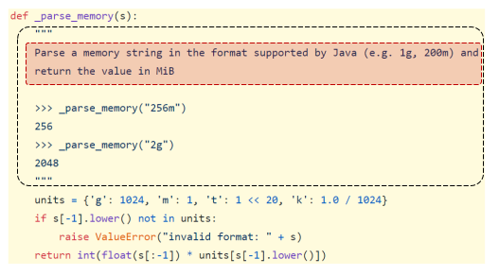
CodeBERT

Slide 7
A Machine Learning Approach Towards SKILL Code Autocompletion
SKILL is a scripting language used to customize and extend EDA software. Electronic Design Automation (EDA).
This paper propose a methodology for creating a high-quality SKILL dataset to then training T5 models, pre-trained on general programming language code, on custom SKILL dataset.
First, a collection of SKILL source code files was gathered from both proprietary and open-source repositories.
These files were then automatically processed to obtain input-output pairs useful for supervised training and evaluation.
https://arxiv.org/pdf/2312.01921

Slide 8
A Machine Learning Approach Towards SKILL Code Autocompletion
There are three pairs types: comment-function, function-completion and comment-code.
In the first case (comment-function pairs), function definitions and preceding comments are the input and the function body is the output.
When there are no preceding comments we have the function-completion pairs.
The comment-code pairs born when a function has long body, so the input include the first parts of the function body with the output being the rest of the body.

Slide 9
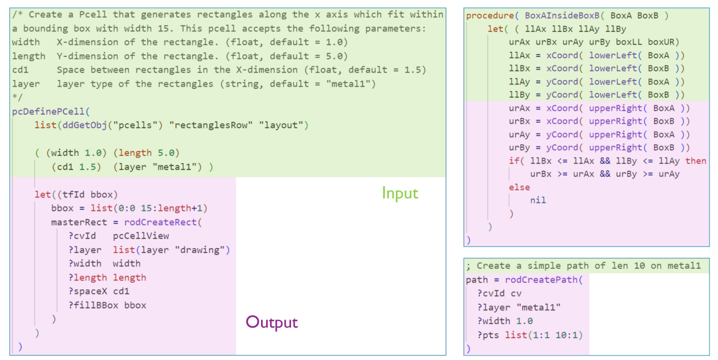
Example for each of the three pair types.

Slide 10
Big Code != Big Vocabulary: Open-Vocabulary Models for Source Code
The datasets described in the paper were designed to train and evaluate neural language models (NLMs) for source code, with a specific focus on addressing challenges such as large vocabularies and out-of-vocabulary (OOV) issues.
These datasets were created to cover three major programming languages: Java, C, and Python. Chosen for their stylistic and structural diversity to ensure comprehensive training data.
All three datasets were created by collecting high-quality open-source projects from GitHub, removing duplicates, and eliminating comments during tokenization.
https://arxiv.org/pdf/2003.07914

Slide 11
Big Code != Big Vocabulary: Open-Vocabulary Models for Source Code
They study a series of modeling choices for source code vocabulary. First of all filtering the vocabulary:
Non-ASCII sequences were replaced with special tokens to avoid parsing errors, while comments were removed.
Replacing comments by placeholder tokens (e.g., <comment>) significantly reduces corpus size, but its effect on vocabulary is limited
Also , string literals can be filtered, replacing them by a placeholder token like <string>

Slide 12
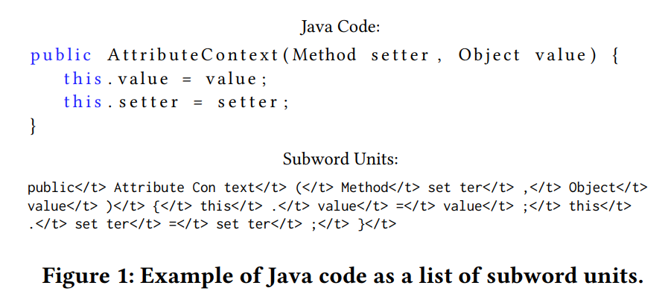
Big Code != Big Vocabulary: Open-Vocabulary Models for Source Code
To tackle the challenges of vocabulary size and OOV terms, the authors employed Byte-Pair Encoding (BPE) to segment identifiers and literals into subwords, significantly reducing the effective vocabulary size.

Slide 13
Big Code != Big Vocabulary: Open-Vocabulary Models for Source Code
Splitting tokens by convention and advanced techniques significantly reduces vocabulary size and OOV rates while introducing trade-offs such as increased sequence lengths, so challenges persist, particularly in balancing vocabulary reduction with preserving contextual and syntactic relationships in source code.
By the way incorporating a diverse and well-preprocessed dataset, the authors ensured that the data reflects a wide variety of programming styles and conventions, enabling models to learn both syntactic and semantic structures and building robust and effective language models for source code.

Slide 14
ML-based Code Autocompletion for Firmware Developers
This paper’s aim is to strengthen the existing machine learning based approaches proposing a “hybrid approach that harnesses the synergy between machine learning techniques and advanced design methods aiming to develop a code auto-completion framework that helps firmware developers[...]”.
The specific objective is to create a model for SSD firmware development.
https://www.mdpi.com/2076-3417/10/23/8520

Slide 15
ML-based Code Autocompletion for Firmware Developers
This paper suggests that source code often include unnecessary information (like comments) that may deteriorate training data quality.
They used a simple Python script to clean the dataset removing comments, unnecessary code, white spaces and empty lines. Lastly it converts all the source codes into one single text fine to easily feed the model.

Slide 16
Source code auto-completion using various deep learning models under limited computing resources
This paper presents various methodologies for source code auto-completion using different Deep Learning models for Python and C# Programming Languages. In a resource-limited environment, it is paramount to reduce various overheads: one way of achieving that is to use the code sequences to train and evaluate rather than using other code structures such as semantics.
This paper compares various deep learning architectures like CodeGPT from Microsoft, Roberta from huggingface and GPT2 for source code auto-completion. Different dataset strategies are employed for comparison, such as (1) treating the whole code file as a single line, (2) using each line as single individual inputs, and (3) tokenizing the codes snippets before feeding them into the models.
https://link.springer.com/article/10.1007/s40747-022-00708-7

Slide 17
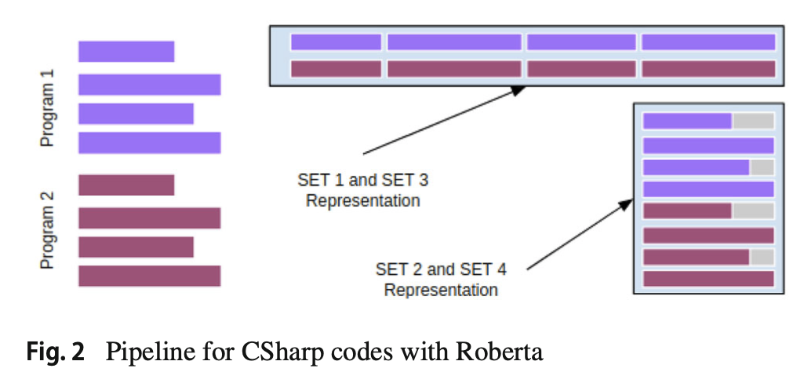
Source code auto-completion using various deep learning models under limited computing resources
The C# dataset, Top 25 GitHub repositories, instead is much smaller, only 23k samples for training and 7k for testing.
The authors created 4 sets using different strategies:
All code in a single line
Code split line by line
Tokenized stream of set 1
Tokenized stream of set 2
Lines with less than 5 tokens were discarded
to improve input quality for the model and avoid context loss due to token truncation.

Slide 18
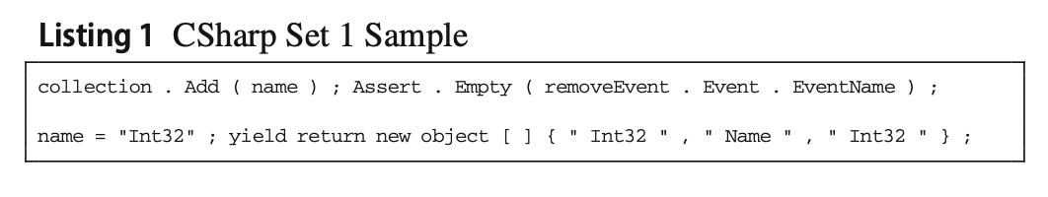
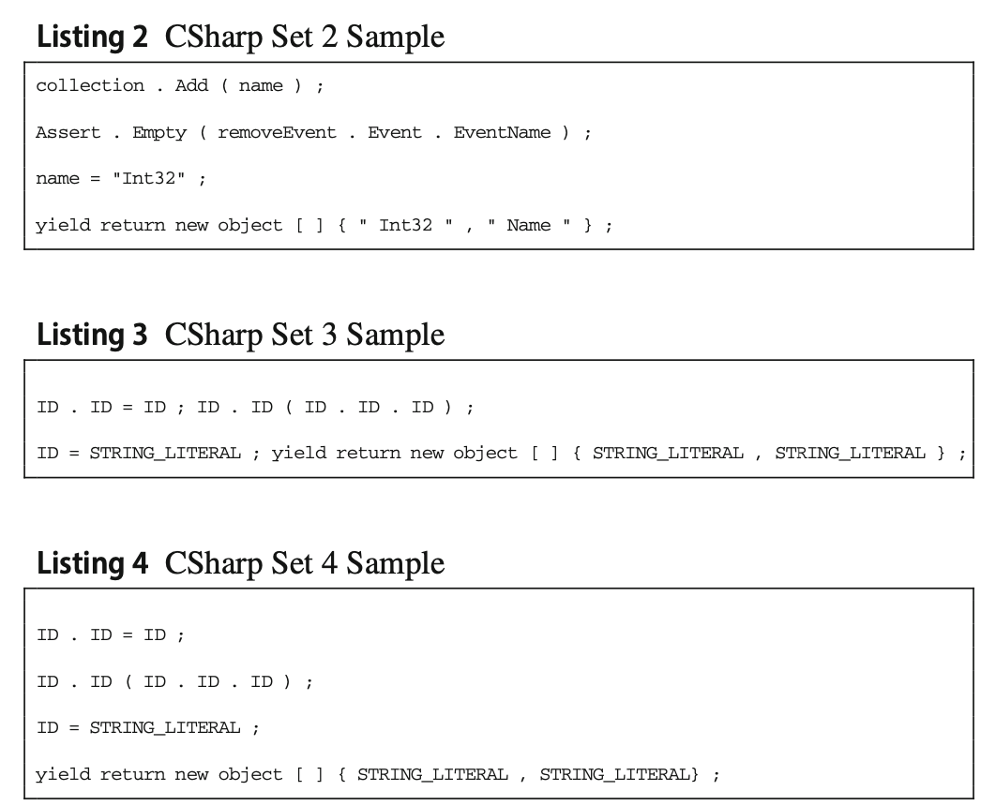
Source code auto-completion using various deep learning models under limited computing resources

Slide 19
Source code auto-completion using various deep learning models under limited computing resources
The Python dataset used is the PY150 Corpus. This dataset contains 150k samples of python code represented as Abstract Syntax Tree (AST).
Since the training happened in Colab under limited resources, it was split into smaller chunks (2.5k to 20k samples).
The code is encapsulated with <s> and </s> tags and they used <EOL> marker to signal the end of the file.
example:
[ {"type":"Module","children":[1,4]},
{"type":"Assign","children":[2,3]},
{"type":"NameStore","value":"x"},
{"type":"Num","value":"7"},
{"type":"Print","children":[5]},
{"type":"BinOpAdd","children":[6,7]},
{"type":"NameLoad","value":"x"},
{"type":"Num","value":"1"} ]

Slide 20
Abstract Syntax Tree
An Abstract Syntax Tree (AST) is a data structure used to represent the structure of a program or code snippet.
It is a tree representation of the abstract syntactic structure of source code written in a formal language. Each node of the tree denotes a construct occurring in the text.
The syntax is "abstract" in the sense that it does not represent every detail appearing in the real syntax, but rather just the structural or content-related details.

Slide 21
Abstract Syntax Tree
Any programming language has an unambiguous context-free grammar, which can be used to parse source code into an AST. Further, the AST can be converted back into source code in a one-to-one correspondence.

Slide 22
Code Completion with Neural Attention and Pointer Networks
This paper presents an innovative approach to code completion exploiting neural networks and pointer mechanisms to improve the prediction of Out-of-Vocabulary (OoV) words.
https://arxiv.org/pdf/1711.09573

Slide 23
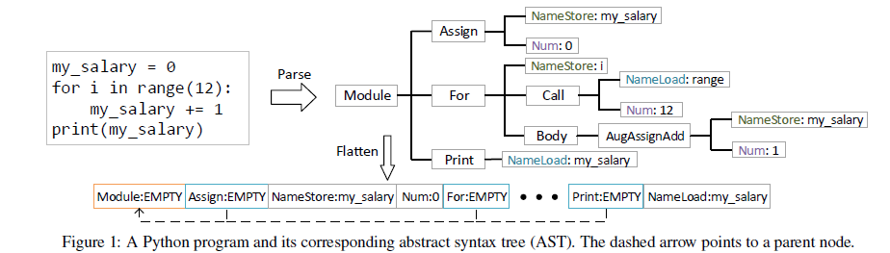
Code Completion with Neural Attention and Pointer Networks
For each leaf node, “:” is used as a separator between type and value. For each non-leaf node, we append a special EMPTY token as its value.

Slide 24
Code Completion with Neural Attention and Pointer Networks
The number of unique node values in both datasets are too large to directly apply neural language models, thus only the first K most frequent values are chosen in each training set to build the global vocabulary, where K is a free parameter. Further there are three special values: UNK for out-of-vocabulary values, EOF indicating the end of each program, and EMPTY being the value of non-leaf AST nodes.

Slide 25
Code Prediction by Feeding Trees to Transformers
This paper proposes a way to “advance the state-of-the-art in the accuracy of code prediction (next token prediction) used in autocomplete systems. Our work uses Transformers as the base neural architecture. We show that by making the Transformer architecture aware of the syntactic structure of code, we increase the margin by which a Transformer-based system outperforms previous systems. With this, it outperforms the accuracy of several state-of-the-art next token prediction systems by margins ranging from 14% to 18%.”
In particular they studied how Abstract Syntax Trees (ASTs) can be serialized as input to existing Transformer models improving their performances.

Slide 26
Code Prediction by Feeding Trees to Transformers
The authors used a modified version of the PY150 dataset. They changed the AST contained in the dataset so that internal nodes only carry syntactic types and the leaf nodes only carry token values.
They decided to handle large trees by slicing them into smaller segments with a sliding window, to keep some of the context, and limit the token vocabulary to 100k, covering most tokens in the dataset. They also decided to cap the maximum path length at 13, keeping nodes near the leaf and truncating those near the root for longer paths.
Positional encoding and Positional embedding are avoided, as early tests showed these methods negatively impacted the performance

Slide 27
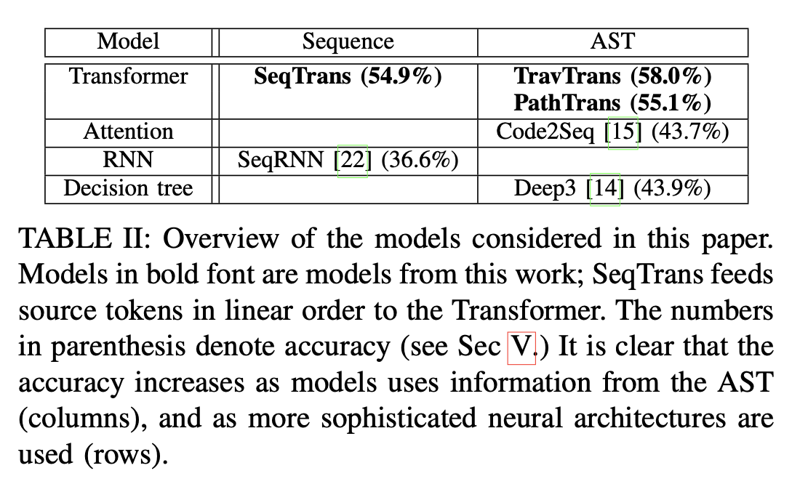
Code Prediction by Feeding Trees to Transformers

